Slide 1
SUPER STORE SALES ANALYSIS REPORT

Slide 2
Content
Objective
Data Preparation
Analytical Methods
Visualizations
Insights and Recommendations

Slide 3
Objective
To contribute to business success by leveraging data analysis techniques, with a strong focus on time series analysis, to deliver actionable insights and accurate sales forecasting for informed decision-making

Slide 4
Data Preparation
Data Import: Imported data from sources like CSV.
Data Cleaning: Handled missing values, removed duplicates, and corrected data types for consistency.
Data Transformation: Used Power Query Editor to split, merge, and restructure data for better insights.
Data Modeling: Created relationships between tables to build an efficient star schema model.
Data Enrichment: Added calculated columns and custom DAX measures for metrics like Total Sales, Profit Margins, and Growth Rates.
Data Validation: Ensured data accuracy by cross-verifying key metrics the original dataset.

Slide 5
Analytical Methods
Descriptive Analysis: Summarized key metrics like total sales, profit, and order quantities.
Comparative Analysis: Compared sales across product categories, regions, and customer segments.
Trend Analysis: Visualized monthly sales and profit trends using Year-over-Year (YoY) comparisons.
DAX Calculations: Used DAX to calculate key performance indicators (KPIs) such as Total Sales, Profit Margins, and Average Delivery Time. Geospatial Analysis: Analyzed sales distribution by state to identify high-performing and low-performing regions.

Slide 6
Visualizations
Bar Charts for Sales by Category, highlighting top-performing products.
Line Charts for Monthly Sales Trends and Profit Analysis using YoY comparisons.
Maps to visualize Sales Distribution by State for geographic insights.
Pie Charts for sales distribution by Segment and Payment Mode.
KPI Cards to display key metrics like Total Sales, Profit, and Order Quantity at a glance.

Slide 7
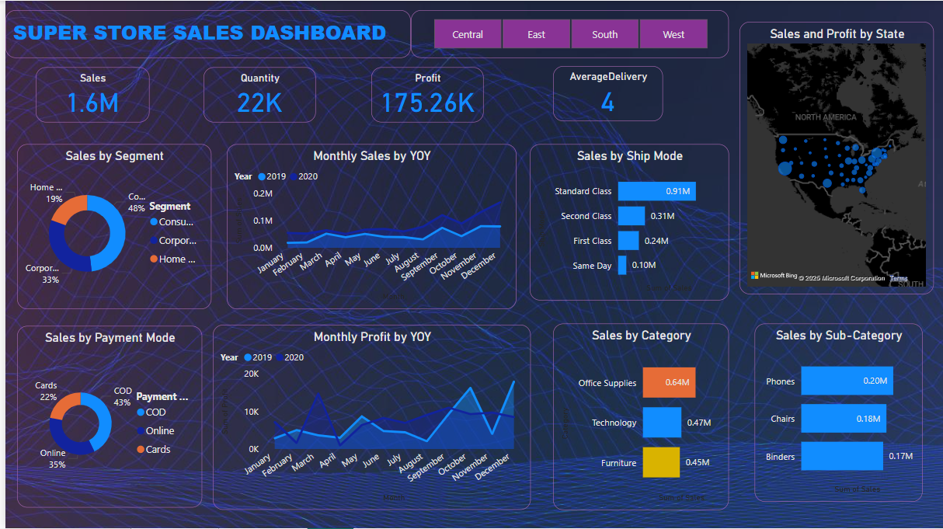
Super Store Analysis Dashboard

Slide 8
Forecasting
Utilized Power BI's Forecasting Tool to predict future sales trends.
Applied Time Series Analysis to identify patterns and seasonality in sales data.
Forecasted future sales using YoY (Year-over-Year) comparisons for improved accuracy.
Provided insights to anticipate peak sales periods and optimize inventory management.
Enhanced decision-making by visualizing projected growth and potential risks.

Slide 9
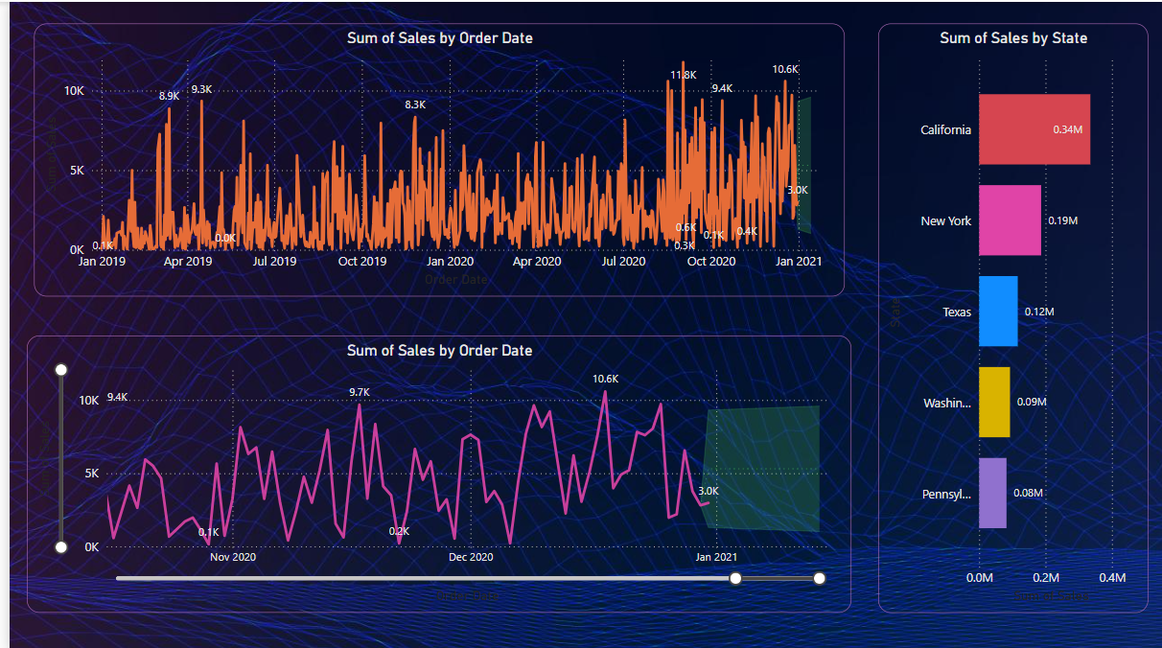
Sales Forecast with Time Series Analysis

Slide 10
Insights
Total Sales reached $1.6M, with Technology contributing the highest at $0.64M.
Total Profit was $175.26K, with Technology showing the strongest profit margin.
California led sales with $340K, followed by New York ($190K) and Texas ($120K).
Standard Class shipping dominated with $910K in sales, while Same Day delivery had only $100K.
The Consumer segment contributed 48% of total sales, outperforming other segments.

Slide 11
Recommandations
Expand Technology Sales: Introduce new products, bundle deals, and promotions to maximize growth.
Boost Furniture Sales: Offer discounts, special offers, or targeted campaigns to improve sales.
Focus on Top Regions: Strengthen marketing efforts in California, New York, and Texas.
Promote Same-Day Delivery: Provide incentives like discounts or loyalty points to increase adoption.
Enhance Online Payments: Improve security and user experience to attract more digital transactions.

